Slide 1
The Chomsky Hierarchy

Slide 2
Linear-Bounded Automata:
Same as Turing Machines with one difference:
the input string tape space
is the only tape space allowed to use

Slide 3







Linear Bounded Automaton (LBA)
Input string
Working space
in tape
Left-end
marker
Right-end
marker
All computation is done between end markers

Slide 4
线性界限自动机（LBA) 计划内的自学课题
一般图灵机，假定带右边无限长，内存无限制
线性界限自动机，假定带右边有限制，内存有限制
实际的计算机都是内存有限的，都是LBA
由于相关内容较简单，理论上较为次要， 自学浏览相关内容
<number>/70

Slide 5
We define LBA’s as NonDeterministic
Open Problem:
NonDeterministic LBA’s
have same power as
Deterministic LBA’s ?

Slide 6
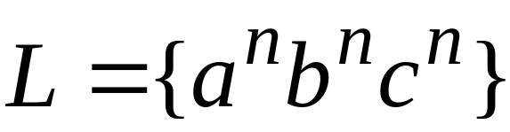
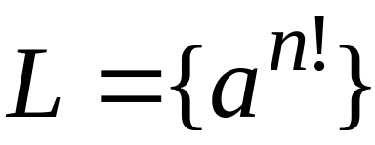
Example languages accepted by LBAs:
LBA’s have more power than PDA’s
(pushdown automata)
LBA’s have less power than Turing Machines

Slide 7

Unrestricted Grammars:
Productions
String of variables
and terminals
String of variables
and terminals

Slide 8
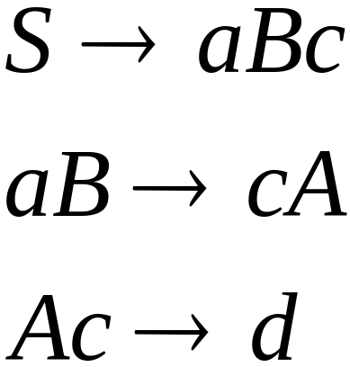
Example unrestricted grammar:

Slide 9

Theorem:
A language is Turing-Acceptable
if and only if is generated by an
unrestricted grammar

Slide 10
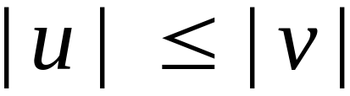
Context-Sensitive Grammars:
Productions
String of variables
and terminals
String of variables
and terminals
and:

Slide 11
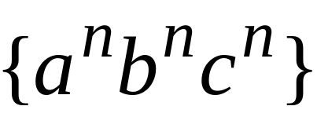
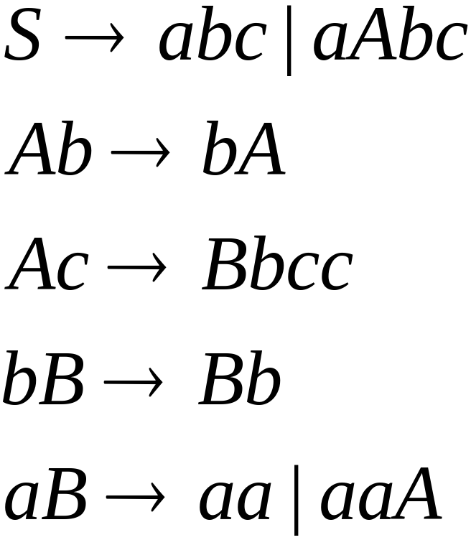
The language
is context-sensitive:

Slide 12
Theorem:
A language is context sensistive
if and only if
it is accepted by a Linear-Bounded automaton
Observation:
There is a language which is context-sensitive
but not decidable

Slide 13


The Chomsky Hierarchy
Non Turing-Acceptable
Turing-Acceptable
decidable
Context-sensitive
0^{n}1^{n}2^{n}
Context-free
0^{n}1^{n}
Regular

Slide 14
LBA接受性问题
LBA接受性问题
  检测一个给定的线性界限自动机
  是否接受一个事先给定的串
语言
A_{LBA}={<M,w>| LBA M接受串w}

Slide 15
引理
引理: 设M是q个状态和
g个带符号的LBA,
对于长度为n的带子,
M恰有qng^{n}个不同格局.
证明: 格局包括当前状态,
带头位置,和带内容.
这三者的不同组合数恰为
qng^{n}. #

Slide 16
定理:A_{LBA}是可判定的.
证明思路: 在输入w上模拟M
如果M停机接受,则接受
如果M停机拒绝,则拒绝
如果M不停机, 则……?
  根据引理,
  如果M运行超过qng^{n}步,
  则M重复了某个格局,
  因此M将陷入死循环
  以上考虑的是确定型LBA,
  对于非确定型LBA, 考虑不同
  格局的排列, 共qng^{n}!种.

Slide 17
定理: A_{LBA}是可判定的
证明: TM L判定A_{LBA}.
L = “对输入<M,w>,
M是LBA,w是串:
1) 在w上模拟M运行qng^{n}步,
或者直到它停机.
2) 如果M停机,
则当M接受时接受,
当M拒绝时拒绝;
如果M还没有停机,
则拒绝. ” #

Slide 18
利用计算历史的归约

Slide 19
计算历史
设M是一个TM, w是一个输入串
M在w上的接受计算历史是
格局序列 C₁,C₂,…,C_{k}, 其中
C₁是初始格局,
每个C_{i}都是C_{i-1}的合法结果
(即符合M的转移函数),
C_{k}是接受格局.
拒绝计算历史: C_{k}是拒绝格局
计算历史都是有穷序列

Slide 20
Representing computations
a/aR
L₁ = {w%w: w ∈{a, b}*}
b/bR
x/xR
q₁
%/%R
q₂
a/aL
q₀
abbaa%abbaa
b/bL
a/aL
a/xL
b/bL
q₁
xbbaa%abbaa
x/xR
x/xL
a/xR
...
q₀
%/%R
q₇
☐/☐R
q_{a}
q₅
%/%R
q₆
q₁
xbbaa%abbaa
b/xR
b/xL
q₂
xbbaa%abbaa
q₃
q₄
q₅
xbbaa%xbbaa
%/%R
...
a/aR
x/xR
xxxxx%xxxxx
b/bR
q_{a}
x/xR

Slide 21
Configurations
A configuration consists of the current state, the head position, and tape contents
configuration
q₁
abq₁a
a
b
a
☐
…
a/bR
q₁
q_{acc}
abbq_{acc}
q_{acc}
…
a
b
b
☐

Slide 22
Computation histories
a/aR
b/bR
x/xR
q₀a₀b₀%₀a₀b₀
x₀q₁b₀%₀a₀b₀
x₀b₆q₁%₀a₀b₀
x₀b₆%₀q₂a₀b₀
x₀b₆q₅%₀x₁b₀
x₀q₆b₀%₀x₀b₀
q₁
%/%R
q₂
a/aL
b/bL
a/aL
a/xL
b/bL
x/xR
x/xL
a/xR
q₀
%/%R
q₇
☐/☐R
q_{a}
q₅
%/%R
q₆
b/xR
b/xL
...
q₃
q₄
%/%R
x₀x₀%₀x₀x₀q₇
x₀x₀%₀x₀x₀☐_{a}q_{a}
a/aR
x/xR
b/bR
x/xR
computation history

Slide 23
Computation histories as strings
If M halts on w, the computation history of
(M, w) is the sequence of configurations
C₁, ..., C_{l} that M goes through on input w.
q₀a₀b₀%₀a₀b₀
x₀q₁b₀%₀a₀b
#q₀ab%ab#xq₁b%ab# . . . #xx%xx☐q_{a}#
...
C₁
C₂
C_{l}
The computation history can be written
as a string hist over alphabet Γ∪Q∪{#}
x₀x₀%₀x₀x₀q₇
x₀x₀%₀x₀x₀q_{a}
accepting history:
M accepts w
q_{acc} occurs in hist
rejecting history:
M rejects w
q_{rej} occurs in hist

Slide 24
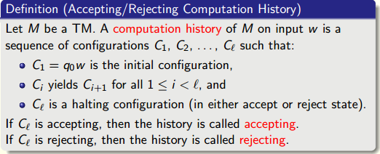
Computation histories as strings

Slide 25
Decidable vs. undecidable
decidable
undecidable
“DFA M accepts w”
“TM M accepts w”
“CFG G generates w”
“TM M halts on w”
“DFAs M and M’ accept
same inputs”
“TM M accepts some input”
“TM M and M’ accept
same inputs”
“CFG G generates all inputs”
“CFG G is ambiguous”
?
L(G1)∩L(G2)=Φ G1 and G2 are all CFG
more?

Slide 26
Undecidable problems for CFGs
ALL_{CFG} = {<G>: G is a CFG that generates all strings}
ALL_{CFG} is undecidable
Reduction
A_{TM} = {<M, w>: M is a TM that does not accept w}
= {<M, w>: M rejects or loops on input w}
A_{TM} is unrecognizable ⇒ A_{TM} is undecidable
If ALL_{CFG} is decidable then A_{TM} is decidable.
Contradiction.

Slide 27
Undecidable problems for CFGs
ALL_{CFG} = {<G>: G is a CFG that generates all strings}
  ALL_{CFG} is undecidable
  Suppose it is decidable, then there exists a universal TM H
    string H(string <G>) {
    // G is a CFG
    if G generates all strings, return “accept”;
    if G does not generates all strings, return “reject”;
    }
Consider the following TM U (dependent on <M> and w)
    string U(string <M>, string w){
    If M does not accept w, return <G> that generates all strings
    If M accepts w, return <G> that does not generate all strings
    }
If we can simulate H(U(<M>,w)), then U decides A_{TM} and so A_{TM} is decidable.

Slide 28
Undecidable problems for CFGs
〈G〉
A
accept if G generates all strings
reject if not
accept
if M rej/loops w
〈M, w〉
construct G
A
〈G〉
reject
if M accepts w
G generates all strings if M rejects or loops on w
G fails to generate some string if M accepts w

Slide 29
Undecidable problems for CFGs
G fails to generate some string
〈M, w〉
construct G
〈G〉
M accepts w
The alphabet of G will be Γ∪Q∪{#}
G will generate all strings except the computation
history of (M, w), if it is accepting
First we construct a PDA P, then convert it to CFG G

Slide 30
Undecidability via computation histories
candidate computation
history hist of (M, w)
P
accept everything
except accepting hist
#q₀ab%ab#xq₁b%ab# . . . #xx%xx☐q_{a}#
reject
P:
// try to spot a mistake in hist
On input hist,
If hist is not of the form #w₁#w₂#...#w_{k}#, accept.
ε
ε
If w₁ ≠ q₀w or w_{k} does not contain q_{a}, accept.
q₀
ε
If two consecutive blocks w_{i}#w_{i+1} do not follow
from the transitions of M, accept.
Otherwise, hist is an accepting history, so reject.

Slide 31
Computation is local
a/aR
b/bR
x/xR
#₀q₀a₀b₀%₀a₀b₀
#₀x₀q₁b₀%₀a₀b₀
#₀x₀b₆q₁%₀a₀b₀
#₀x₀b₆%₀q₂a₀b₀
#₀x₀b₆q₅%₀x₁b₀
#₀x₀q₆b₀%₀x₀b₀
q₁
%/%R
q₂
a/aL
b/bL
a/aL
a/xL
b/bL
x/xR
x/xL
a/xR
q₀
%/%R
q₇
☐/☐R
q_{a}
q₅
%/%R
q₆
b/xR
b/xL
...
q₃
q₄
%/%R
#₀x₀x₀%₀x₀x₀q₇
#₀x₀x₀%₀x₀x₀☐_{a}q_{a}
a/aR
x/xR
b/bR
x/xR
Changes between configurations always occur around the head

Slide 32
Legal and illegal transition windows
legal windows
illegal windows
… ₆a₃b₀x₀ …
… ₀a₆b₀x₀ …₀
… ₆q₂a₀b₀ …
… ₀a₆b₀q₂ …₀
… ₆a₃q₂a₀ …
… ₀q₅a₆x₀ …₀
… ₆q₂q₂a₀ …
… ₀q₂q₂x₃ …₀
q₂
a/xL
… ₆a₃b₀a₀ …
… ₀a₆b₀q₅ …₀
… ₆a₃q₂a₀ …
… ₀q₅a₆b₀ …₀
q₅
… ₆a₃a₀☐₀ …
… ₀x₆a₀☐₀ …₀
… ₆a₃q₂a₀ …
… ₀a₆q₅x₀ …₀

Slide 33
Implementing P
If two consecutive blocks w_{i}#w_{i+1} do not follow
from the transitions of M, accept:
#₀x₀b₆%₀q₂a₀b
#₀x₀b₆q₅%₀x₁b
For every position of w_{i}:
Remember offset from # in w_{i} on stack
offset
Remember first row of window in state
After reaching the next #:
Pop offset from # from stack as you consume input
Remember second row of window in state
If window is illegal, accept;
Otherwise reject.

Slide 34
The computation history method
ALL_{CFG} = {〈G〉: G is a CFG that generates all strings}
If ALL_{CFG} can be decided, so can A_{TM}.
G accepts all strings except accepting computation histories of (M, w)
We first construct a PDA P, then convert it to CFG G
〈M, w〉
construct G
〈G〉

Slide 35
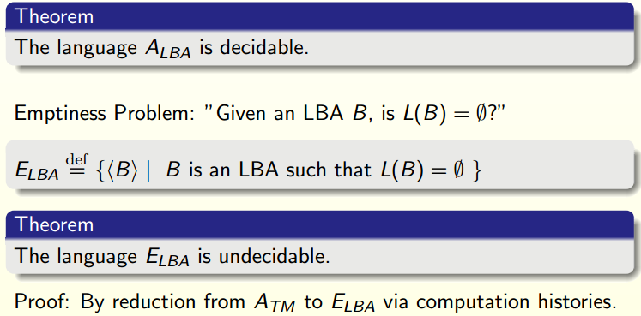

Slide 36
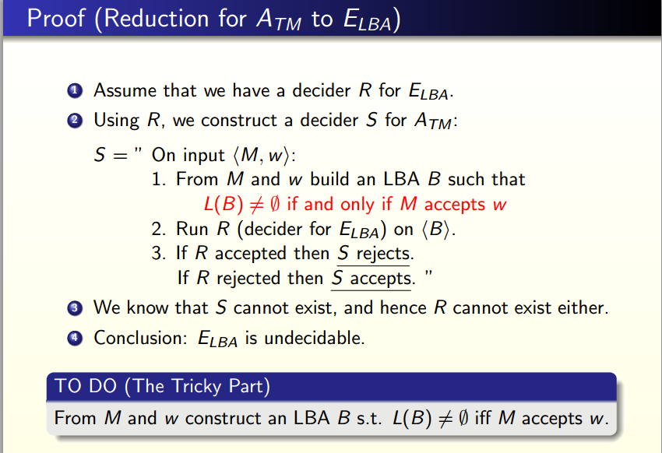

Slide 37
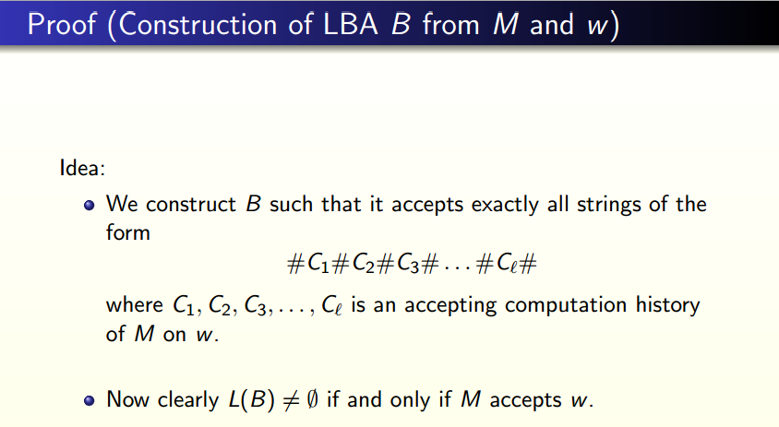

Slide 38
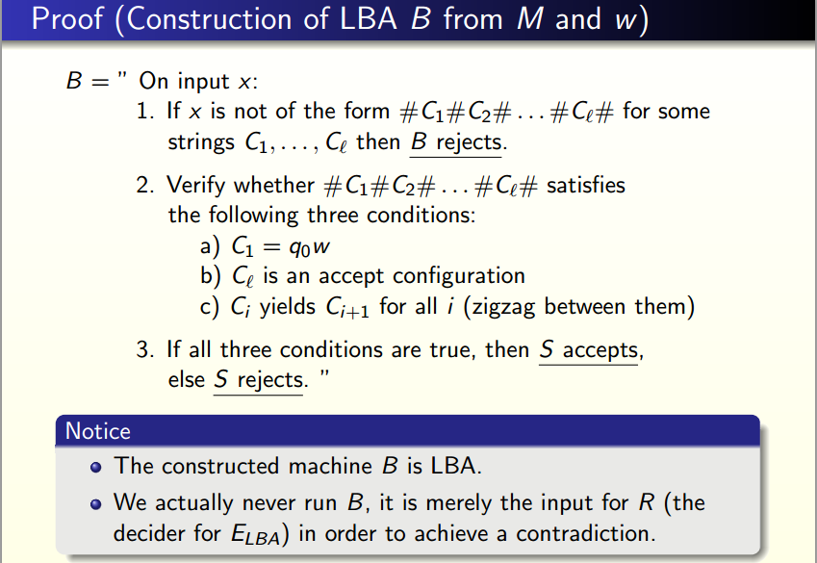
B
B

Slide 39
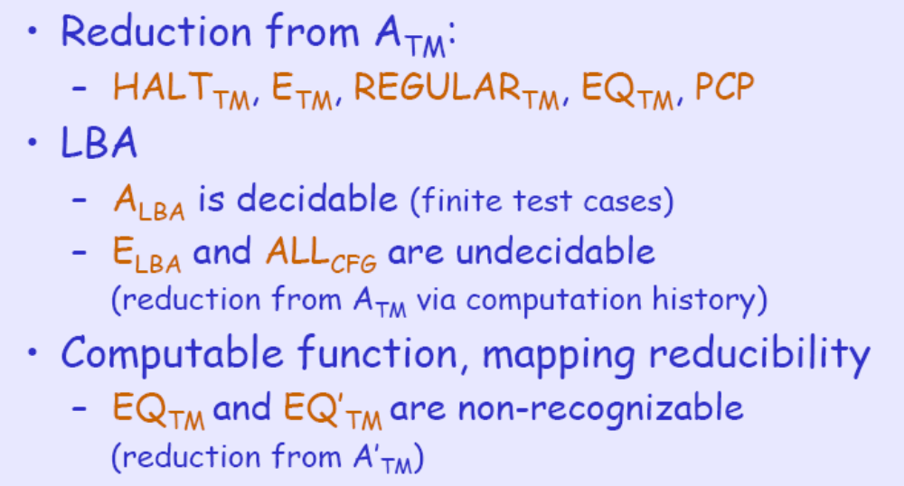
What we have learnt

Slide 40
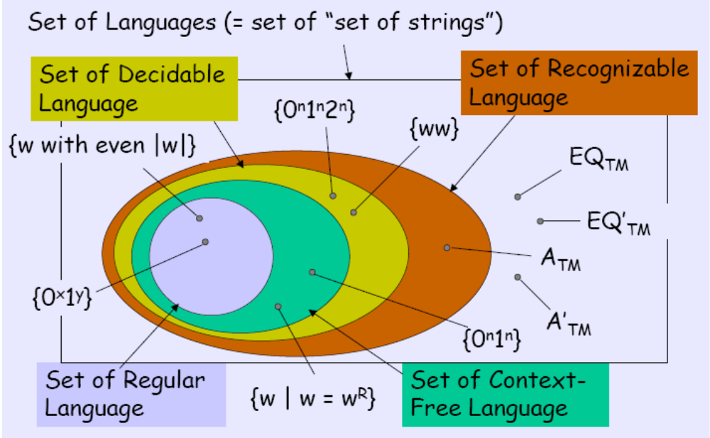
Language Hierarchy(revisited)

